Slide 1

Probability foundations
Notes on Behavioural Economics
Jason Collins

Slide 2


Slide 3
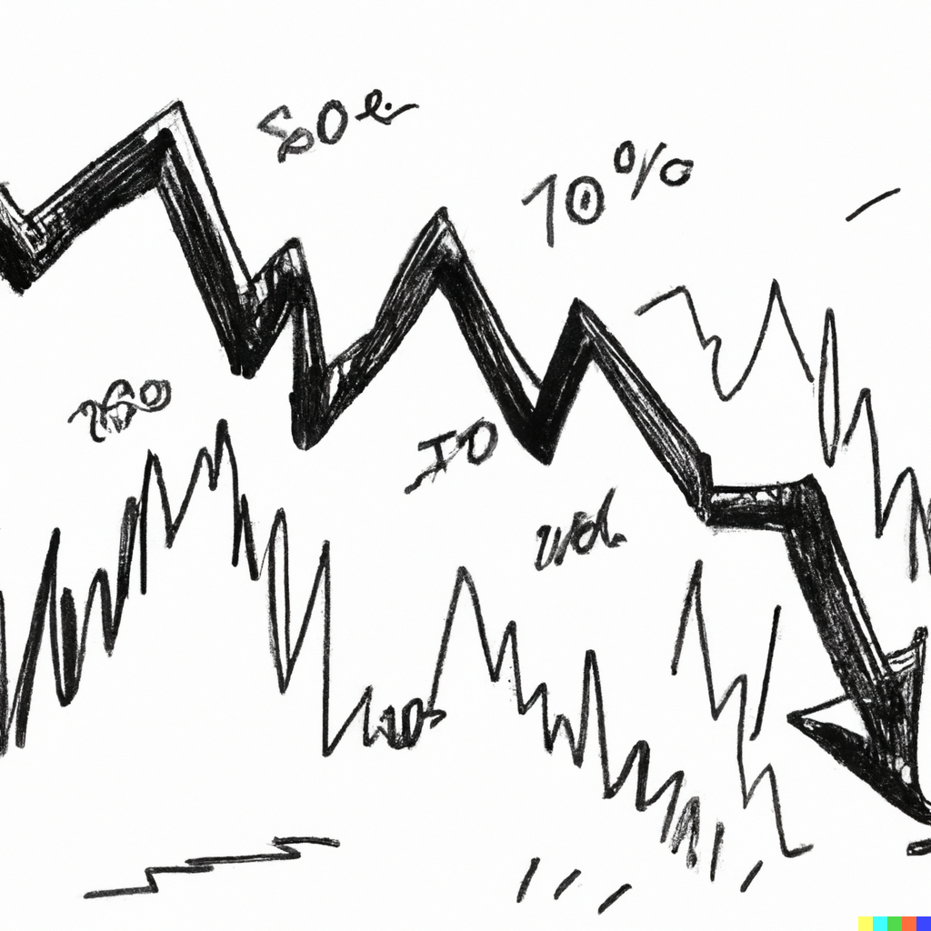

Slide 4
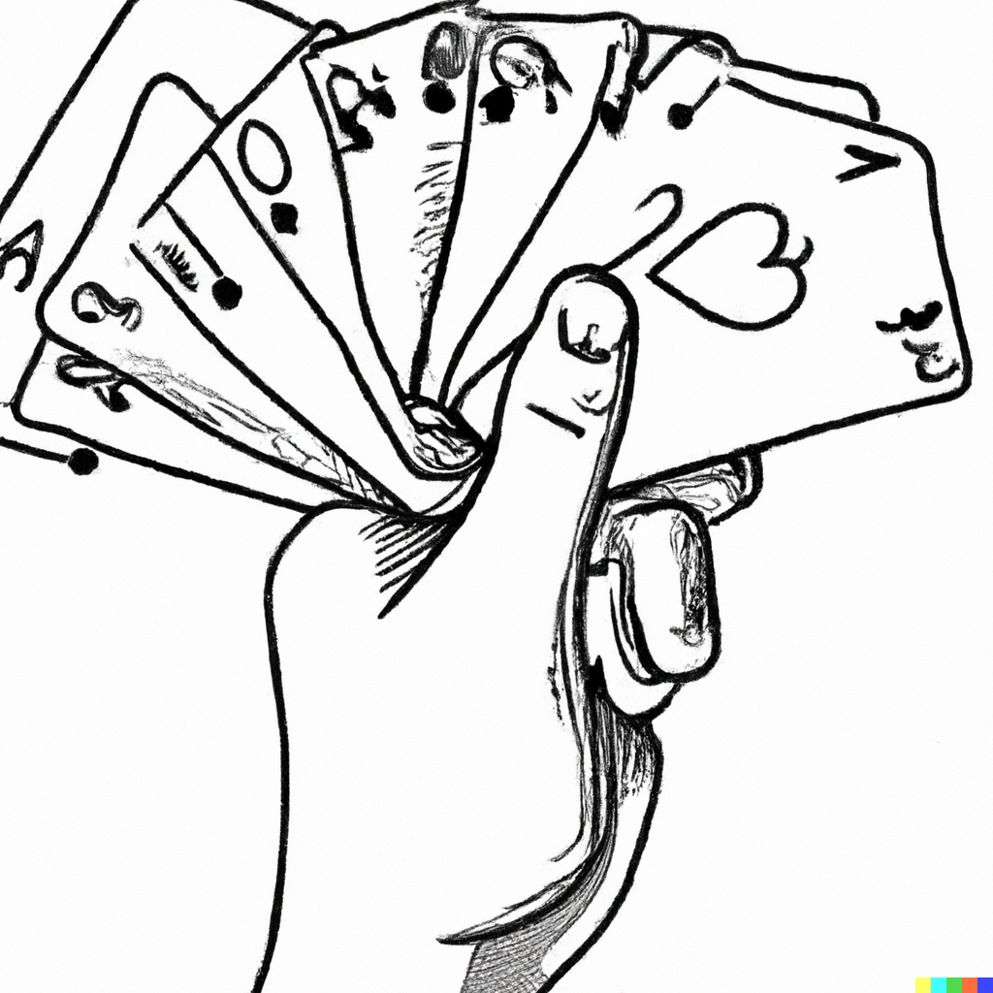

Slide 7
Probability foundations
Probability theory
Bayes’ rule
Subjective expected utility theory

